Slide 1

How the Internet Works
Special thanks to Steve Palica for helping me with the content of these slides.

Slide 2
Fun Facts and Statistics
The Internet weighs about as much as a strawberry.
The backbone of the Internet consists of over 550,000 miles of undersea cable.
About 5.331 Billion people have access to the Internet.
Projected to be 6.2 Billion people by 2028.
About 42% of Internet traffic is bots.

Slide 3
What Happens When You Enter google.com Into Your Browser’s Search Bar?
Assumptions:
You just turned your computer on.
You have already joined the Wi-Fi network you are on previously.
Knowledge Assumptions:
You all know what an IP Address is.
You all know what a MAC Address is.

Slide 4
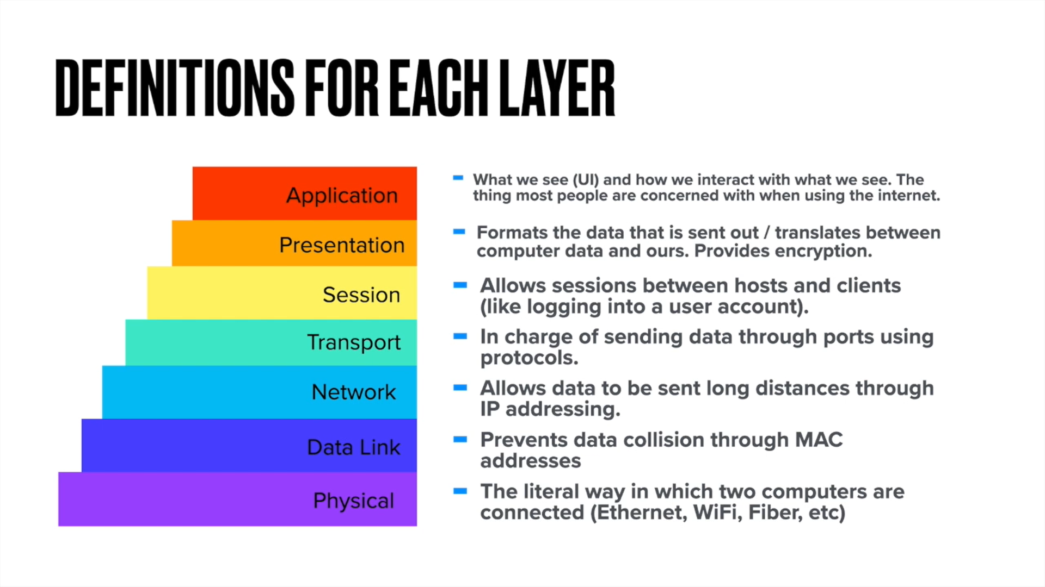
OSI Model

Slide 5
First You Need a Few Things - DHCP
DHCP: Dynamic Host Configuration Protocol.
IP Address
Subnet Mask
Default Gateway
DNS Server
Your computer sends a broadcast request for these 4 things and the local DHCP server (often the router) responds with them.
Now you can access the Internet! Right?

Slide 6
How Does Your Computer Know How to Get To google.com? DNS
DNS: Domain Name System.
Humans understand words that make sense: google.com. This is a domain.
Computers don’t speak the same language as us.
Your computer needs to know which IP address relates to google.com.

Slide 7
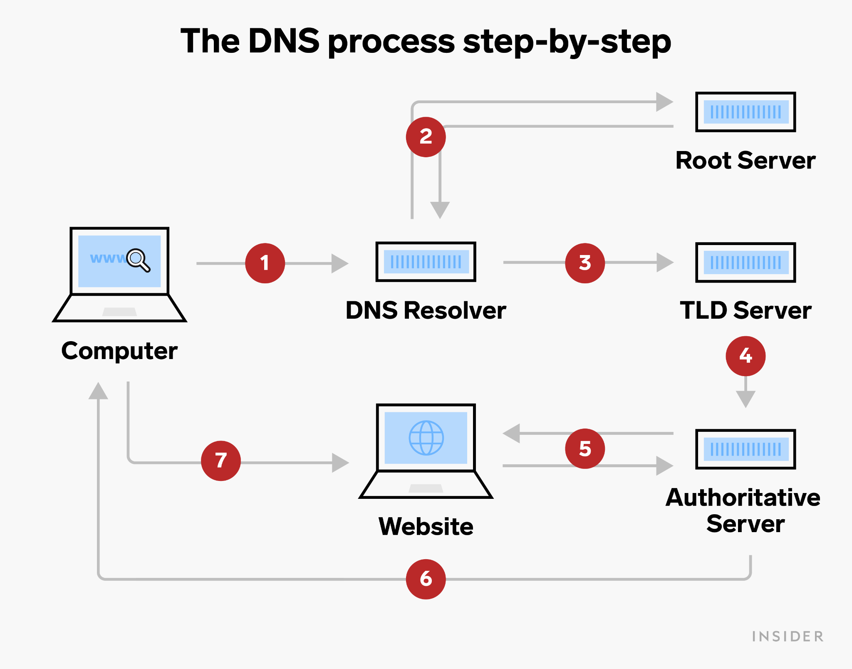
DNS cont.
DNS Cache
DNS Server
Root Server
TLD Server
Authoritative Name Server

Slide 8
Now Your Computer Can Reach Out to Google - HTTP(S)
HTTP(S): Hypertext Transfer Protocol (Secure).
If HTTPS, a TLS 3-way handshake occurs.
Transport Layer Security
Key exchange for encryption
Your web browser forms an HTTP GET request containing information of what you want (google.com).
Important: Source and Destination IP/MAC Addresses.
The request is broken up into packets and encrypted using the established TLS key.

Slide 9
Off We Go!!!
Your computer uses its Network Interface Card to format the packet information into physical pulses of electricity (ethernet) or radio waves (Wi-Fi).
Default Gateway (router) receives the packets and decodes them.

Slide 10
Routers
The main job of a router is to route traffic between networks.
The router checks its routing table to see if it has an entry for the destination IP address (or how to get there).
Yes? Router forwards packet there. Often this is another router.
Your packets keep going from router to router until it gets to google.com
No? Router drops the packet and tells your computer that there is no such path.

Slide 11
We Made It!!!
Google’s web server receives your packets!
The packets are de-encapsulated and de-encrypted.
The server processes the packets and reads what you want access to.
Server responds with an HTTP Response
200 OK: Everything worked and you get the web files.
400 Error: Something went wrong with your request (404 Not Found).
500 Error: Internal Server Error.

Slide 12
It All Comes Full Circle
Google responds to your computer using the same process that your computer used (but not always as many steps are needed).
When your computer receives the data, it processes the data and displays google.com for you.

Slide 13
Sources
https://github.com/BYU-ITCSA/Dark-Mode/tree/main/Lesson%20x:%20How%20the%20Internet%20Works
https://www.statista.com/topics/1145/internet-usage-worldwide/#dossier-chapter1
https://askleo.com/wp-content/uploads/2018/10/internet.jpg
https://www.businessinsider.com/guides/tech/what-is-a-dns-server

